Slide 1
.NET
Free. Cross-platform. Open source.
A developer platform for building all your apps.
www.dot.net

Slide 2

Presentation title
Speaker name

Slide 3
Click to edit
First level
Second level
Third level
Fourth level
Fifth level

Slide 4
Click to edit
First level
Second level
Third level
Fourth level
Fifth level
First level
Second level
Third level
Fourth level
Fifth level

Slide 6
Demo
Presenter

Slide 7
Code sample
Code sample

Slide 9

Thanks for joining !

Slide 10







Slide 11
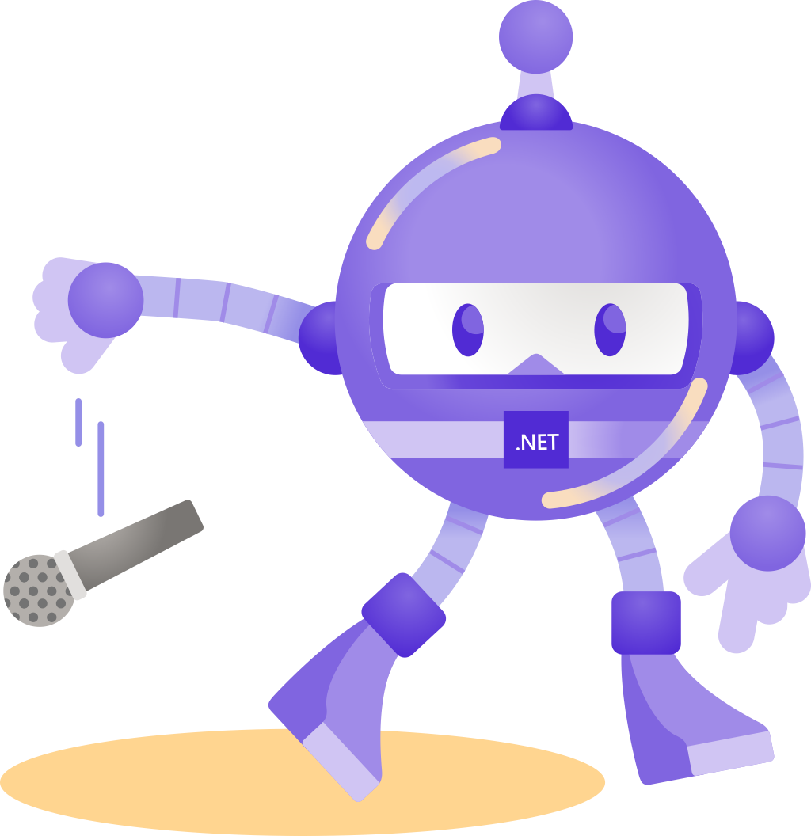


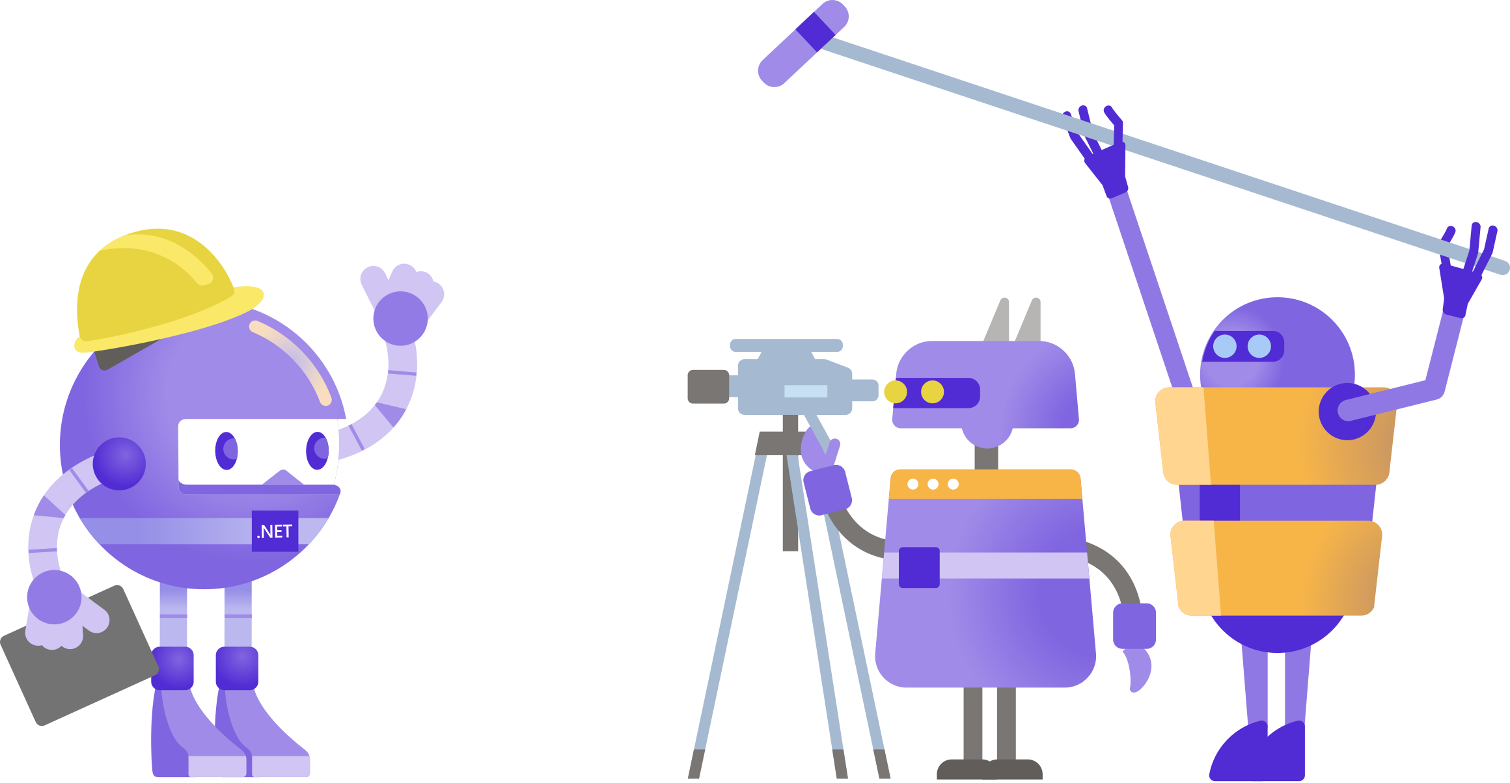
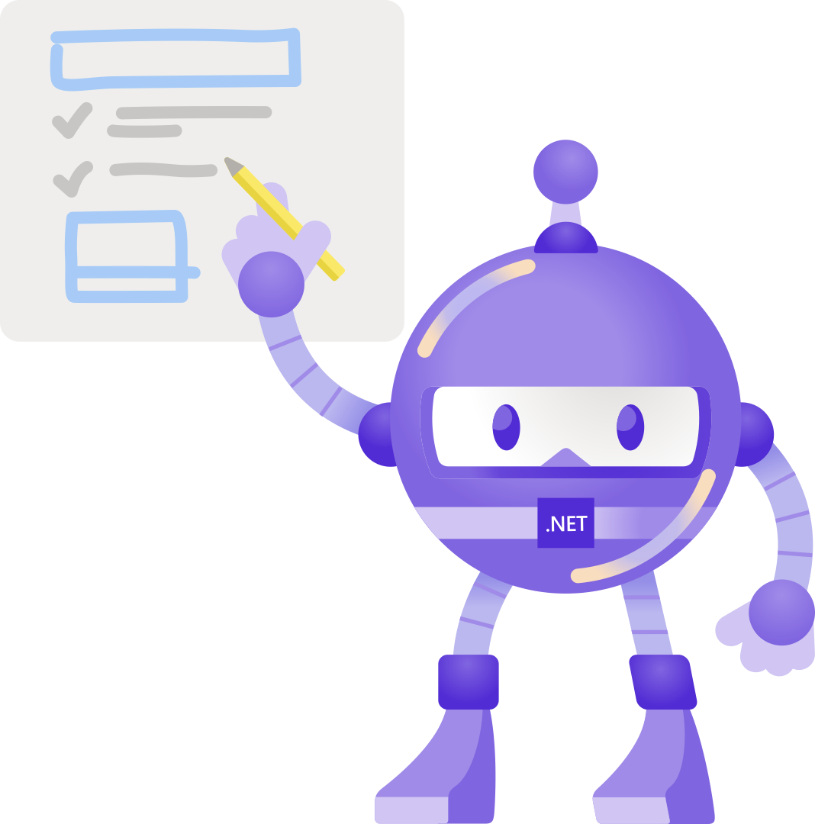


Slide 12


Slide 13


Slide 14


Slide 15


